Slide 1

Financial Sales Dashboard
Prepared by
Mary Motunrayo Lawal
Data Analyst Internship – Task 3
Tool Used: Microsoft Power BI

Slide 2
Project Overview
Objective
The objective of this project was to design an interactive dashboard using Microsoft Power BI to monitor sales performance and support data-driven business decisions
Dataset
Financial Sample Dataset (Microsoft)
Tool Used: Microsoft Power BI
Dashboard Type: Interactive Business Dashboard
Features
KPI Cards
Sales Trend Analysis
Product Performance Analysis
Country Performance Analysis
Sales by Segment
Interactive Filters (Slicers)
Page Navigation

Slide 3
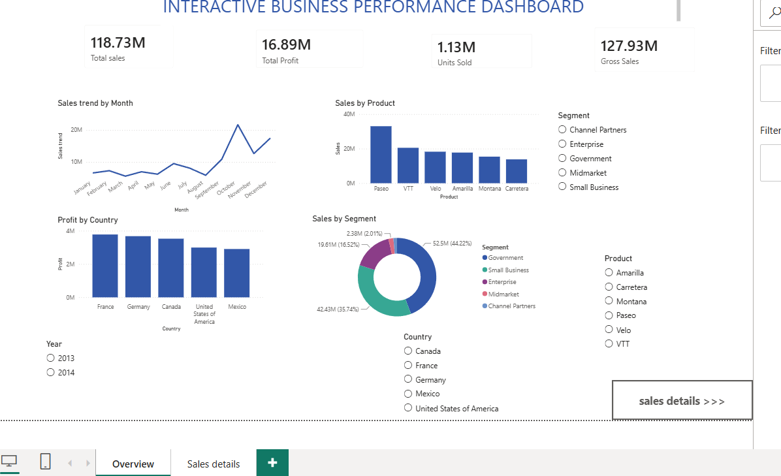
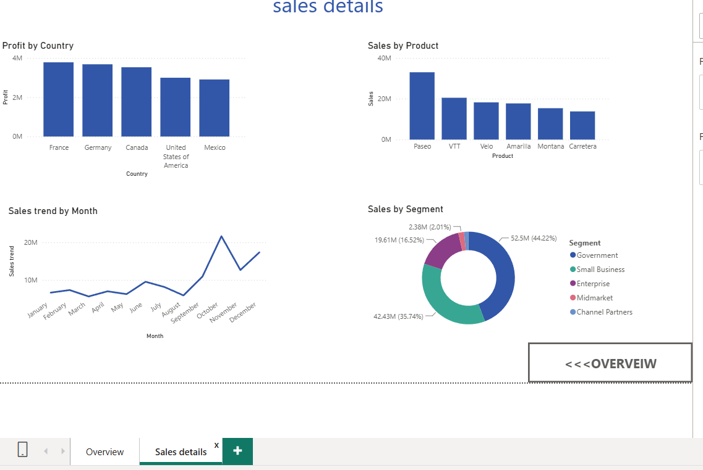
Dashboard Overview
Dashboard Components
The dashboard provides a summary of the company's sales performance through interactive visualizations, including:
Total Sales,Total Profit,Gross Sales,Units Sold,Sales Trend by Month,Sales by Product,Profit by Country,Sales by Segment
Users can interact with the dashboard using slicers to filter the report and view specific business insights.

Slide 4
Key Insights
The dashboard revealed the following business insights:
Total Sales recorded: 118.73M.
Total Profit recorded: 16.89M.
Gross Sales reached: 127.93M.
Approximately: 1.13M units were sold.
Product sales performance varied across different products.
Profit differed across countries, helping identify stronger-performing markets.
Monthly sales trends highlighted changes in business performance over time.
Interactive filters allow users to explore the data from different perspectives.

Slide 5
Conclusion
This interactive Power BI dashboard provides a clear and effective overview of the company's sales performance.
It enables users to:
Monitor key business performance indicators (KPIs).
Analyze sales trends over time.
Compare product and country performance.
Make informed business decisions using interactive visualizations and filters.
This project demonstrates the use of Microsoft Power BI to transform raw data into meaningful business insights through data visualization.

Slide 6
Thank You

